Slide 1
Recent Observations of Small Solar Energetic Particle Events
J. Luhmann
for the IMPACT/SEP team

Slide 2
Solar Activity is Increasing
2008 transition from CIR to SEP events
Although quiet still see small activity
ULEIS sees more because of lower energy and higher sensitivity
Most 2009 events seen at 1 or 2 s/c
Slightly larger events in 2010
Notes:
Lower panel is expansion of upper panel showing events seen by more than 1 spacecraft
(3 panels are STEREO-B, ACE, STEREO-A)

Slide 3
Examples of ³He-rich Events
Several events were seen by STEREO-B/A and ACE
1 event seen by all 3
Two examples
Feb 2 (ACE + STEREO-A)
Feb 12 (all 3 spacecraft)
Notes:
Going to show examples of 2 events, both have some 3He
At the moment don’t have detailed ACE/ULEIS data, so only showing STEREO data (mostly LET, since that’s what I have at hand)

Slide 4
³He-rich Event of Feb 2
³He-rich throughout event
Enhancement is high
STEREO-A
³He
⁴He
Notes:
Clear 3He enhancement
Time profile is 4 hour averages
Small event, but clear

Slide 5
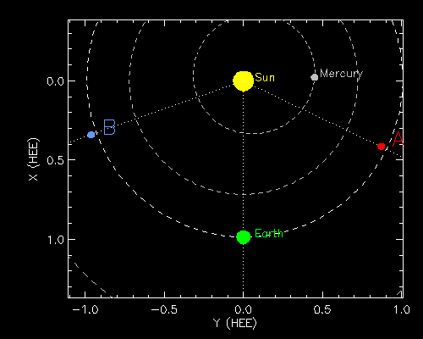
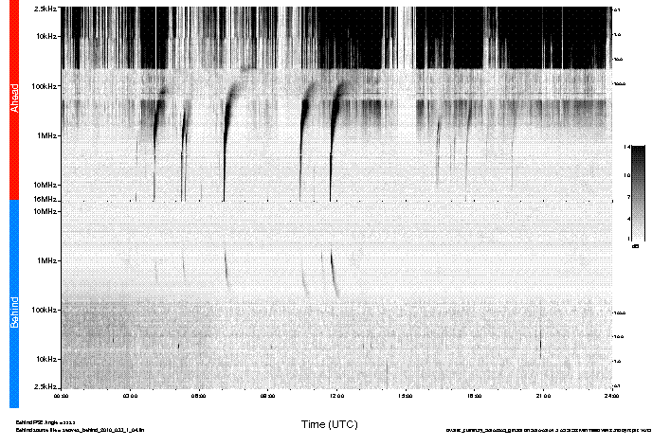
³He-rich Event of Feb 2
³He-rich throughout event
Enhancement is high
Strong anisotropy from 45° to Sun-line
No evidence of CME
Type III bursts on SWAVES-A
Sun
71°
65°
STEREO-A
EUVI
Notes:
No flare ID. My guess is that it was the active region to near CM of STEREO-A, to the south (red circle). However that is still beyond the limb for ACE, so surprising that ACE/ULEIS saw the event.
Note that the Type III bursts don’t really show up on B, probably occulted

Slide 6
³He-rich Event of Feb 2
Not sure that ACE and STEREO-A are seeing same event
Start time is a little different
Composition seems different
Notes:
However, there is a bit of a question as to whether ACE and STEREO-A are really seeing the same event.
Lines on plot mark rough (by eye) estimate of onset times… slightly different
Based on density of dots, STEREO-A seems to be seeing higher 3He/4He in this event than ACE (but I don’t have a ACE/ULEIS histogram)

Slide 7
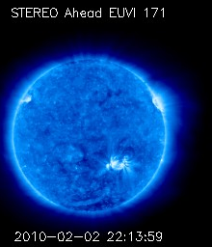
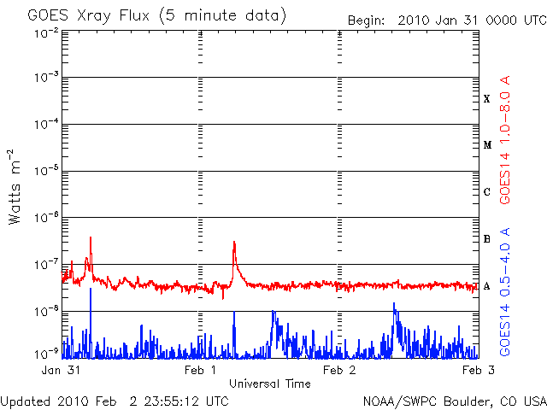
³He-rich Event of Feb 2
Not sure that ACE and STEREO-A are seeing same event
Start time is a little different
Composition seems different
But, no other AR candidates for ACE
Flare too small for GOES?
Maybe in 0.5-4 Å
SOHO EIT
Notes:
No flare seen – maybe because too small or because it was behind the limb for GOES
No real other candidate source regions for ACE (other than the bright spot just over the limb to the south)

Slide 8
³He-rich Event of Feb 12
Seen by STEREO-A+B (and ACE)
³He time profile different in STEREO-A not in STEREO-B
STEREO-B
STEREO-A
Notes:
3He and 4He have similar dependence for –B but not for –A, but this may be because the STEREO-B 3He trace is just spillover from 4He
But 4He has similar features between –A and –B, at least for the first part of the event. Around 15-Feb, the 4He on STEREO-A looks different (maybe another injection) (will get back to that in a minute)

Slide 9
³He-rich Event of Feb 12
Seen by STEREO-A+B (and ACE)
³He time profile different in STEREO-A not in STEREO-B
Composition different
STEREO-B
STEREO-A
Notes:
Note different y-axis scales in –A and –B. More 4He in –B (which is why it might be mostly spillover for 3He)
But this may be a time-dependent effect since 3He time profile is so different in –A.

Slide 10
³He-rich Event of Feb 12
Seen by STEREO-A+B (and ACE)
³He time profile different in STEREO-A not in STEREO-B
Composition different
Anisotropy
Small for STEREO-A
Odd angle for STEREO-B
STEREO-B
STEREO-A
Notes:
-B anisotropy suggestive of coming from perpendicular to expected field direction (have not checked the orientation of the B-field during this time)
-A and –B anisotropies are time dependent (not shown)

Slide 11
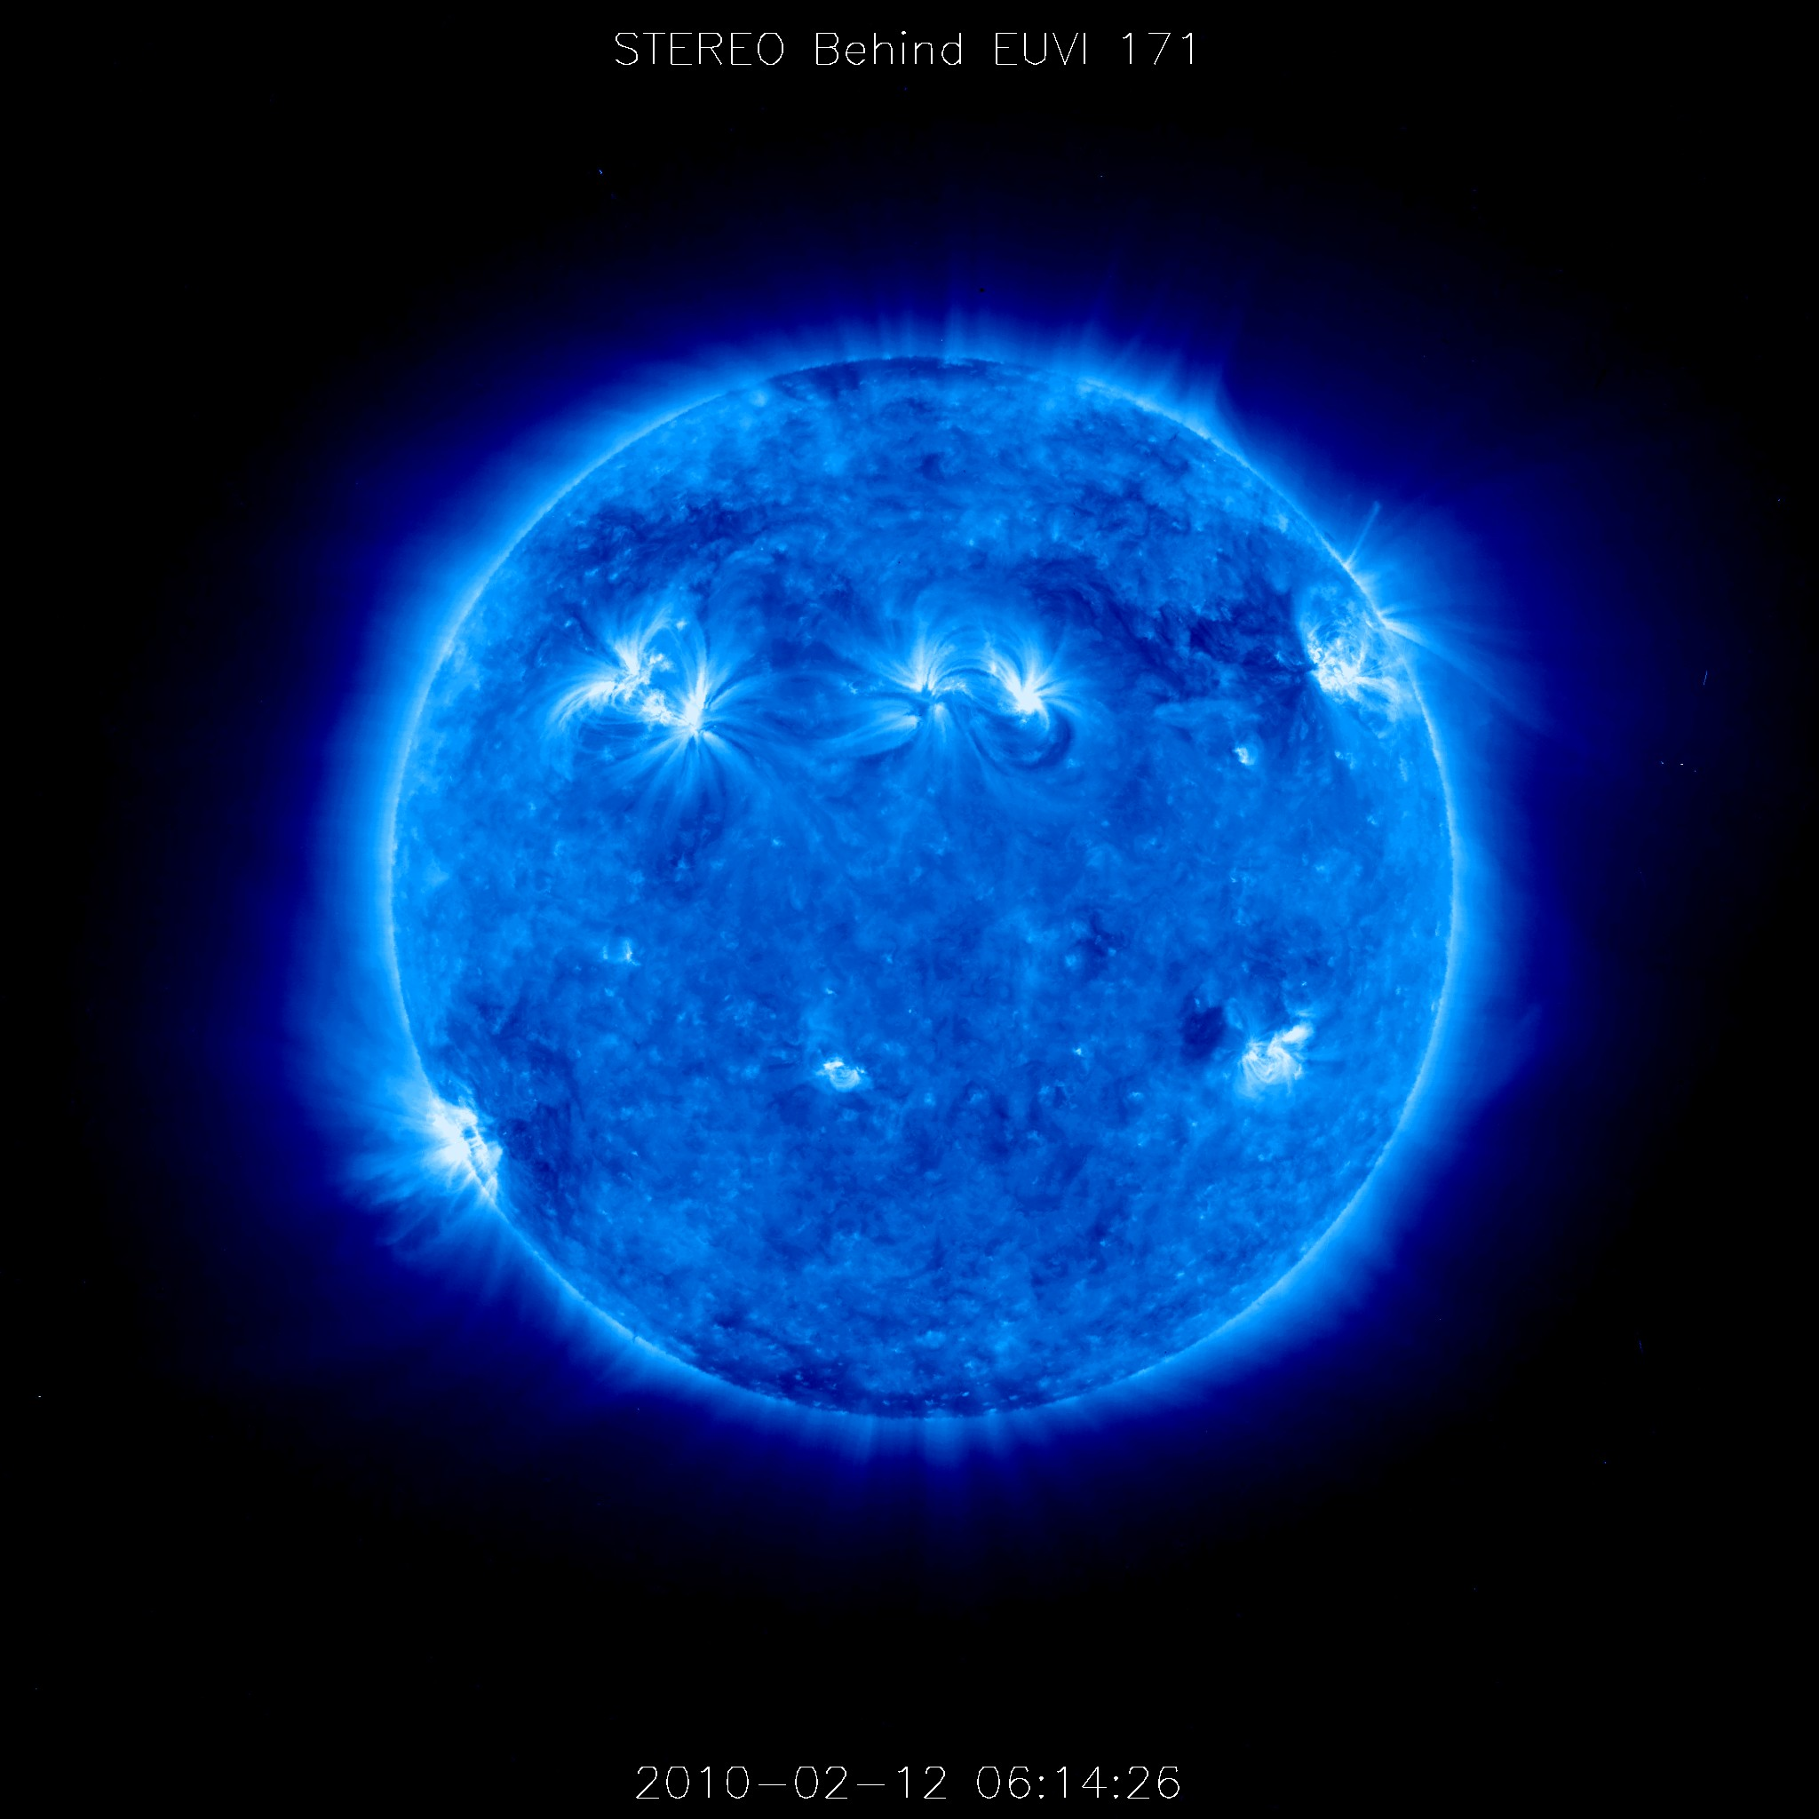
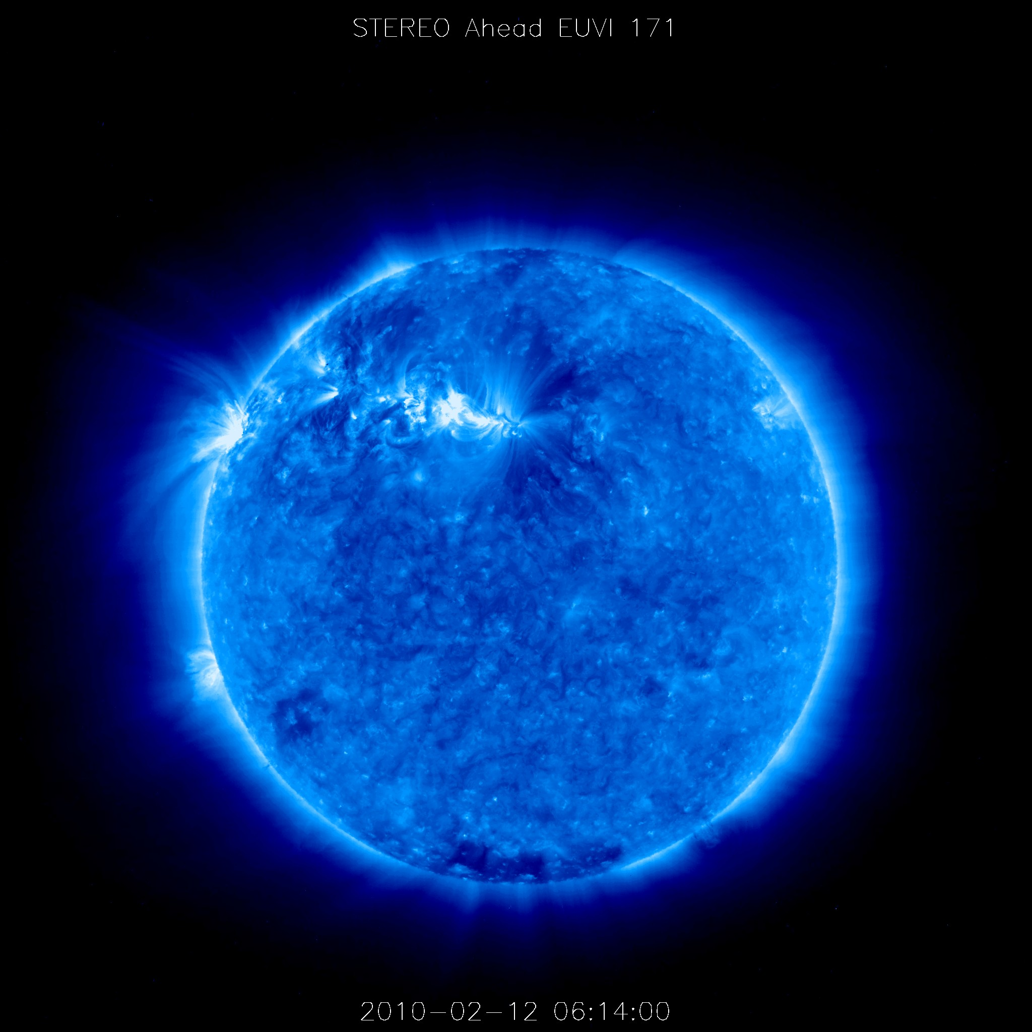
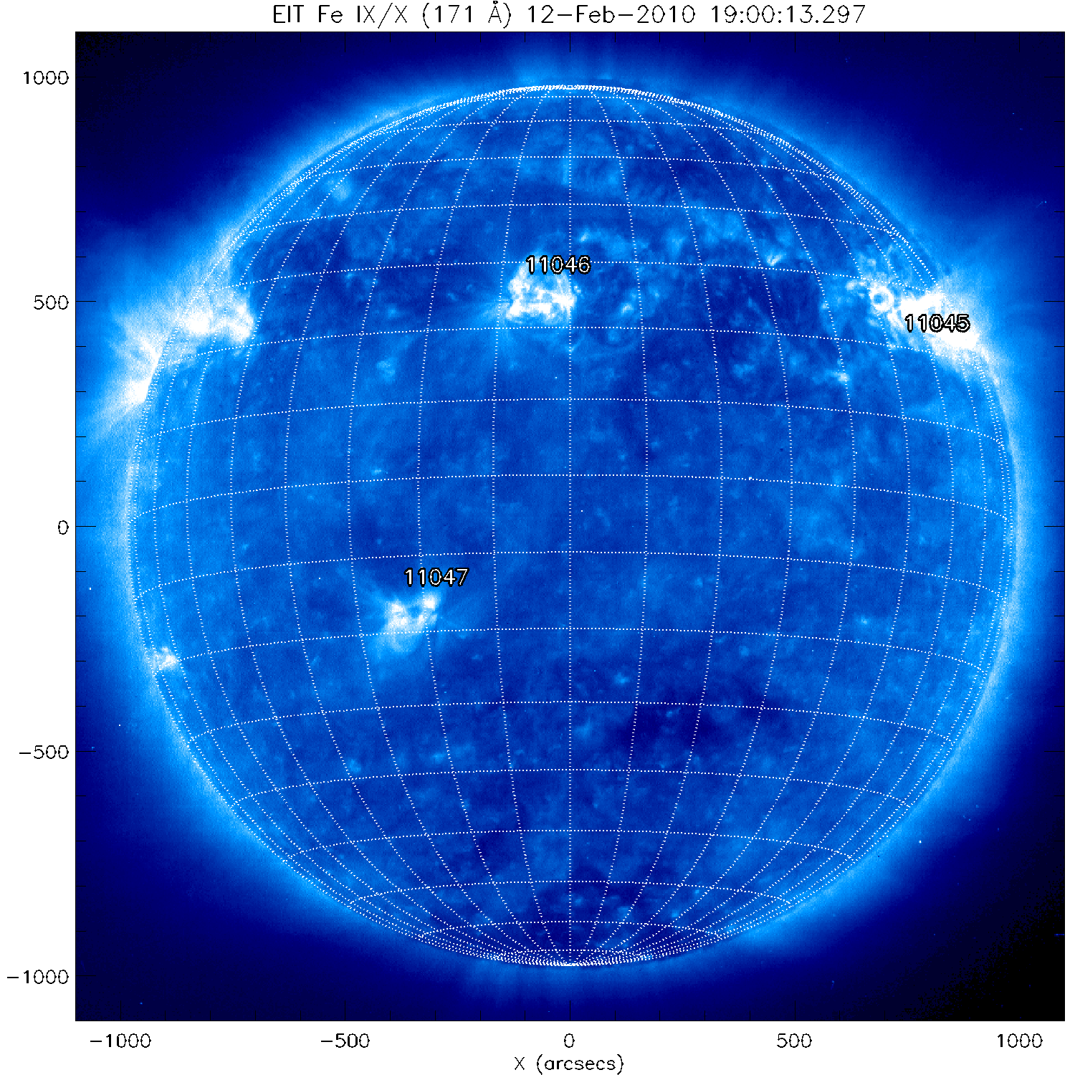
³He-rich Event of Feb 12
Are these the same events?
⁴He profiles similar, why not ³He?
Possible that ³He in STEREO-B is all spillover
But would expect to see ³He towards end of event
How can it span 130+°?
CME? (none listed)
Suggestion of CME in COR1 movies
N31E20
STEREO-A
STEREO-B
ACE
Notes:
Suggestion of CME around 7:50-8 in movies for –B (http://stereo.gsfc.nasa.gov/browse/2010/02/12/behind_20100212_cor1_512.mpg)
and –A (http://stereo.gsfc.nasa.gov/browse/2010/02/12/ahead_20100212_cor1_512.mpg)
If –A and –B would have seen same 3He profile, the level is such that would have exceeded the 4He spillover later in the event (after 15-Feb), but no evidence of that.
This GOES flare is my best guess for the source of the main part (start) of the event (on 12-Feb) It is AR 1046

Slide 12
³He-rich Event of Feb 12
Later ³He may be separate event not seen by STEREO-B
Second injection on 15-Feb
STEREO-A
12-Feb
15-Feb
12-Feb
15-Feb
Notes:
If look at electrons (SIT and HET), see a second injection at STEREO-A around 15-Feb
Protons at different energies also show possibly second event around this time; also true for the lower energy He (lower than shown in plot to the left with 3He which is 2.3-3.8 MeV/n)
So appears to be a second event that contributes to the 3He seen in the yellow highlighted region on the plot to left (not seen on STEREO-B)

Slide 13
³He-rich Event of Feb 12
Later ³He may be separate event not seen by STEREO-B
Second injection on 15-Feb
STEREO-A sees jet early on 15-Feb at well connected region
Notes:
This is a possible source for the second injection.
Poor man’s movie shows jet coming out of region to the west (well connected). Note that the jet shoots out in a southward direction (which is probably needed to see particles from it at the ecliptic plane). Jets have been associated with 3He-rich SEP events.
This region is well behind the east limb for STEREO-B, so wouldn’t be seen. Not clear what ACE would have seen (since it would have been behind the west limb, but haven’t examined the ACE data in that detail yet).

Slide 14
Continuing Increase in Activity
Sunspot number continues to rise
Expect continued increase in activity
Challenge is identifying sources for multiple spacecraft
Notes:
We expect to have more events seen by multiple spacecraft.
Challenge is always to accurately identify source and attribute s/c observational difference to the correct cause (connection, different sources, etc).

